Slide 1
CSE 145: Developing a Multi-Faceted Integrated Navigation System For Triton AI Racing
Michael Ruddy

Slide 2
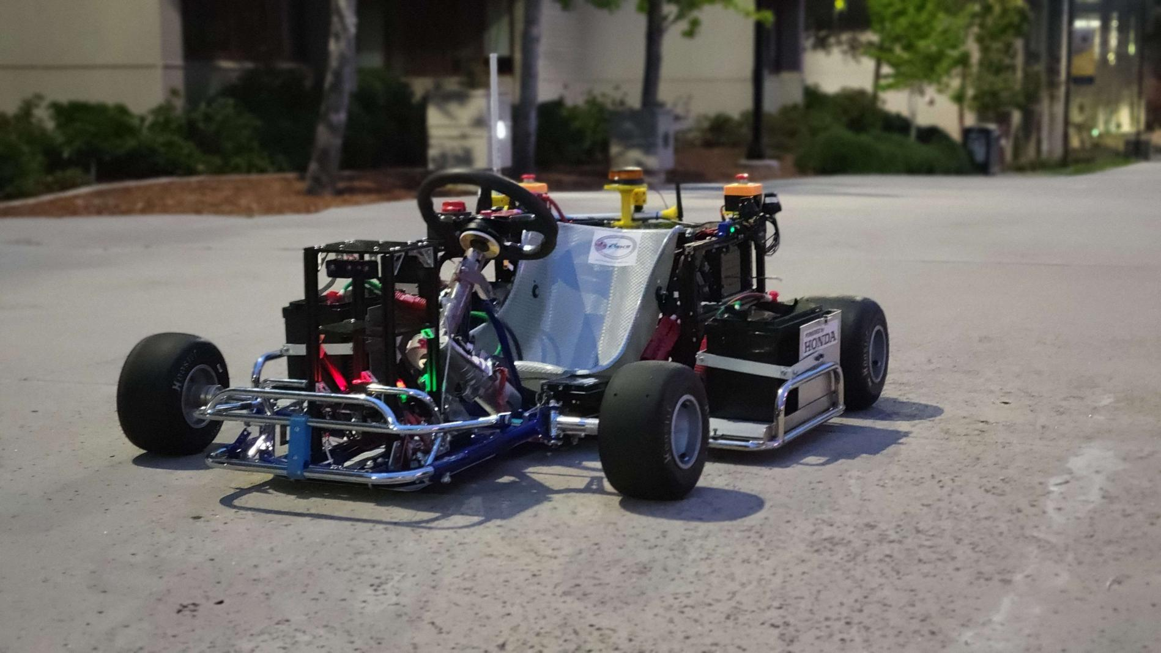
BiG Goal: Fast, Smart Karts
Triton-AI
AKS(Autonomous Karting Series)- Learn Track, Race
My job - GPS,IMU,Atlas, P1 SDK

Slide 3
What Did I Do?
Enable and use GNSS on the ATLAS
Access raw IMU data from the P1SDK

Slide 4
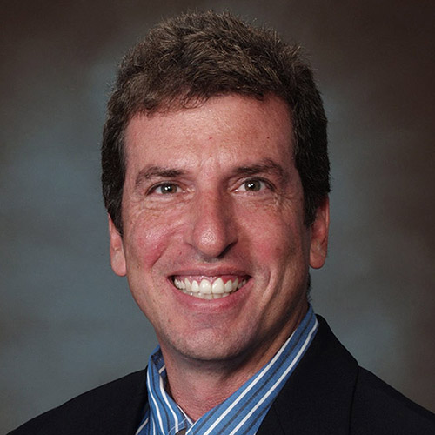
The First Mission
Alexei and Michael
Let me get you two to work together to get the Atlas demonstrate working this week
Thank you
Jack

Slide 5
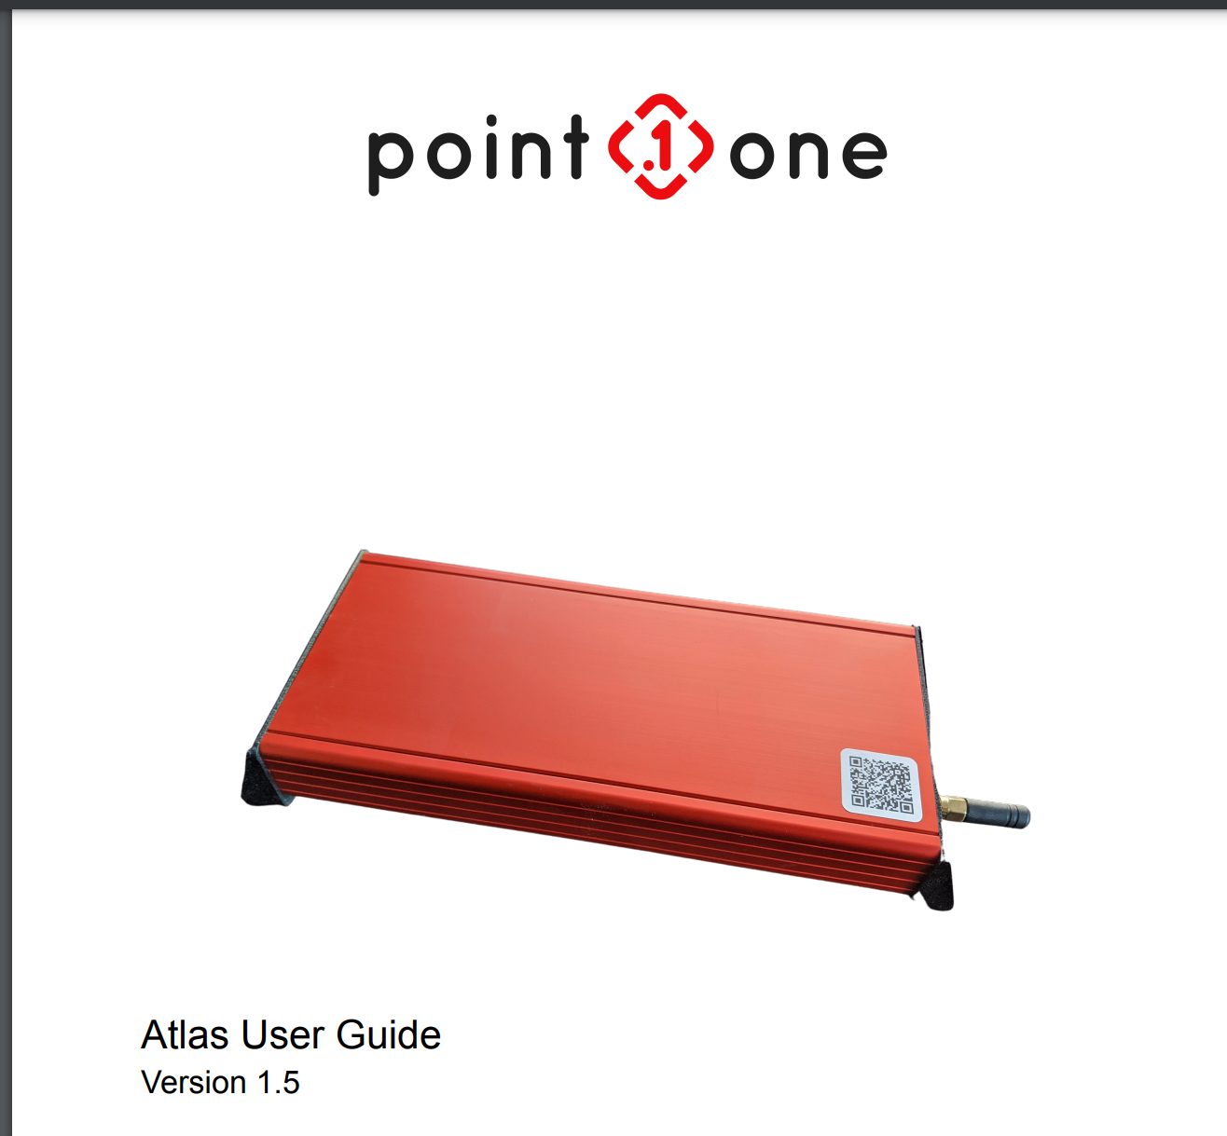
Ground Work
Students who knew device graduated
Doc Diving

Slide 6
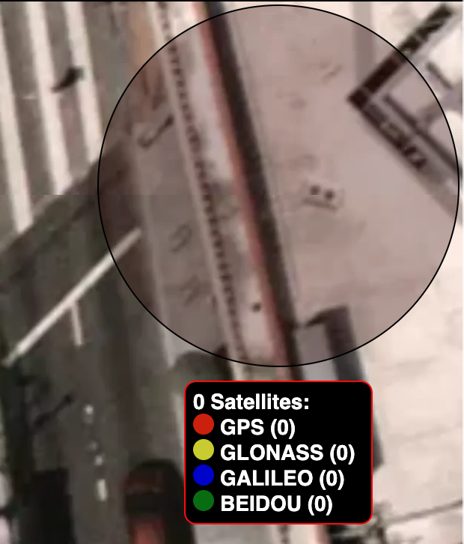
Problem: Establishing TCP Connection + Getting GPS DATA
ros2 run fusion-engine-driver fusion_engine_ros_driver --ros-args -p connection_type:=tcp -p tcp_ip:=192.168.10.211 -p tcp_port:=30201
[INFO] [1682630910.504785079] [fusion_engine_node]: Error connecting to target device: Connection refused (111)

Slide 7
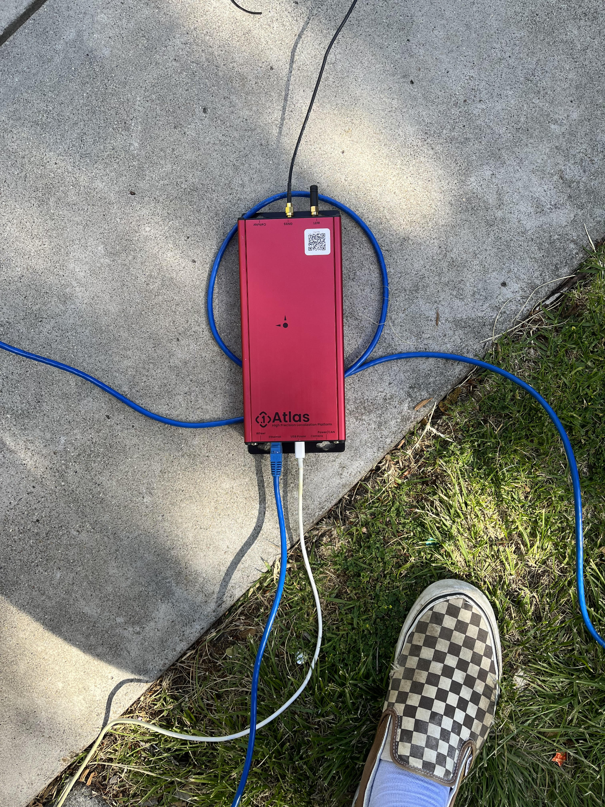
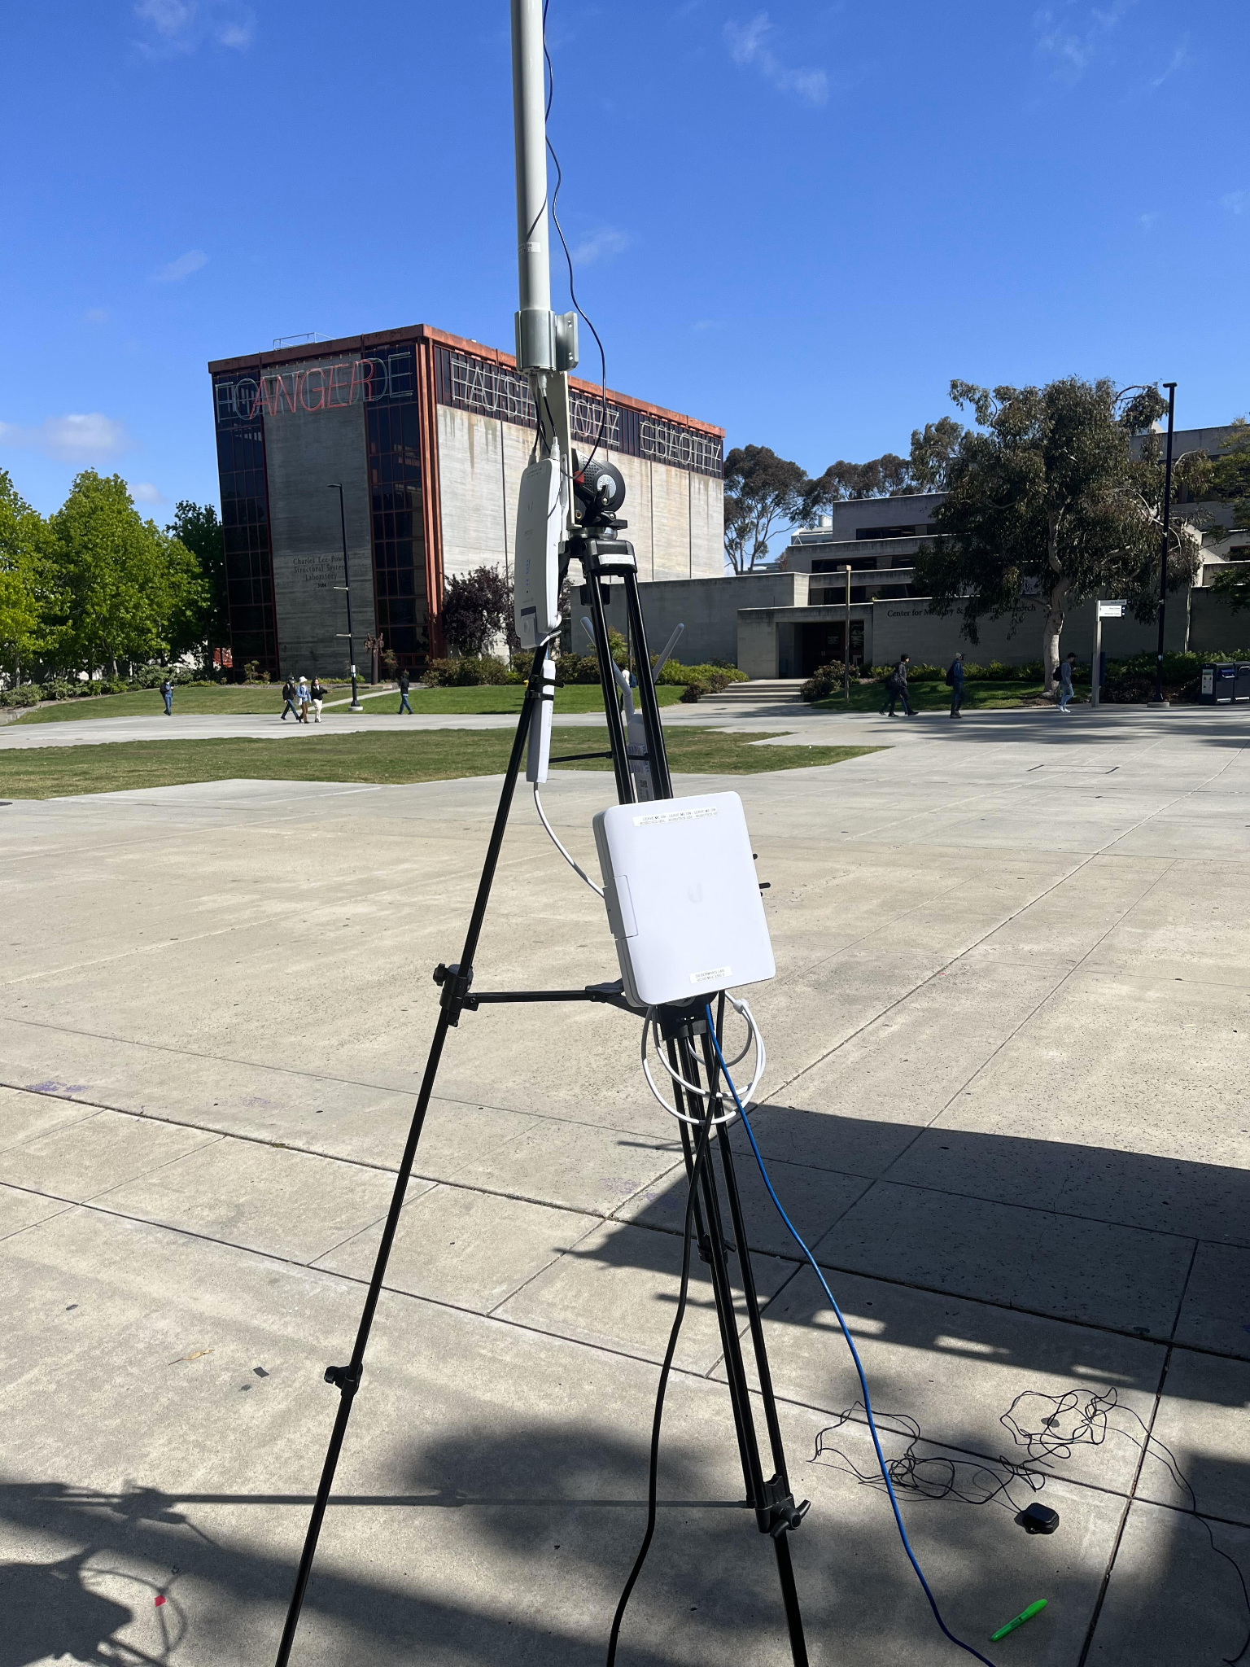
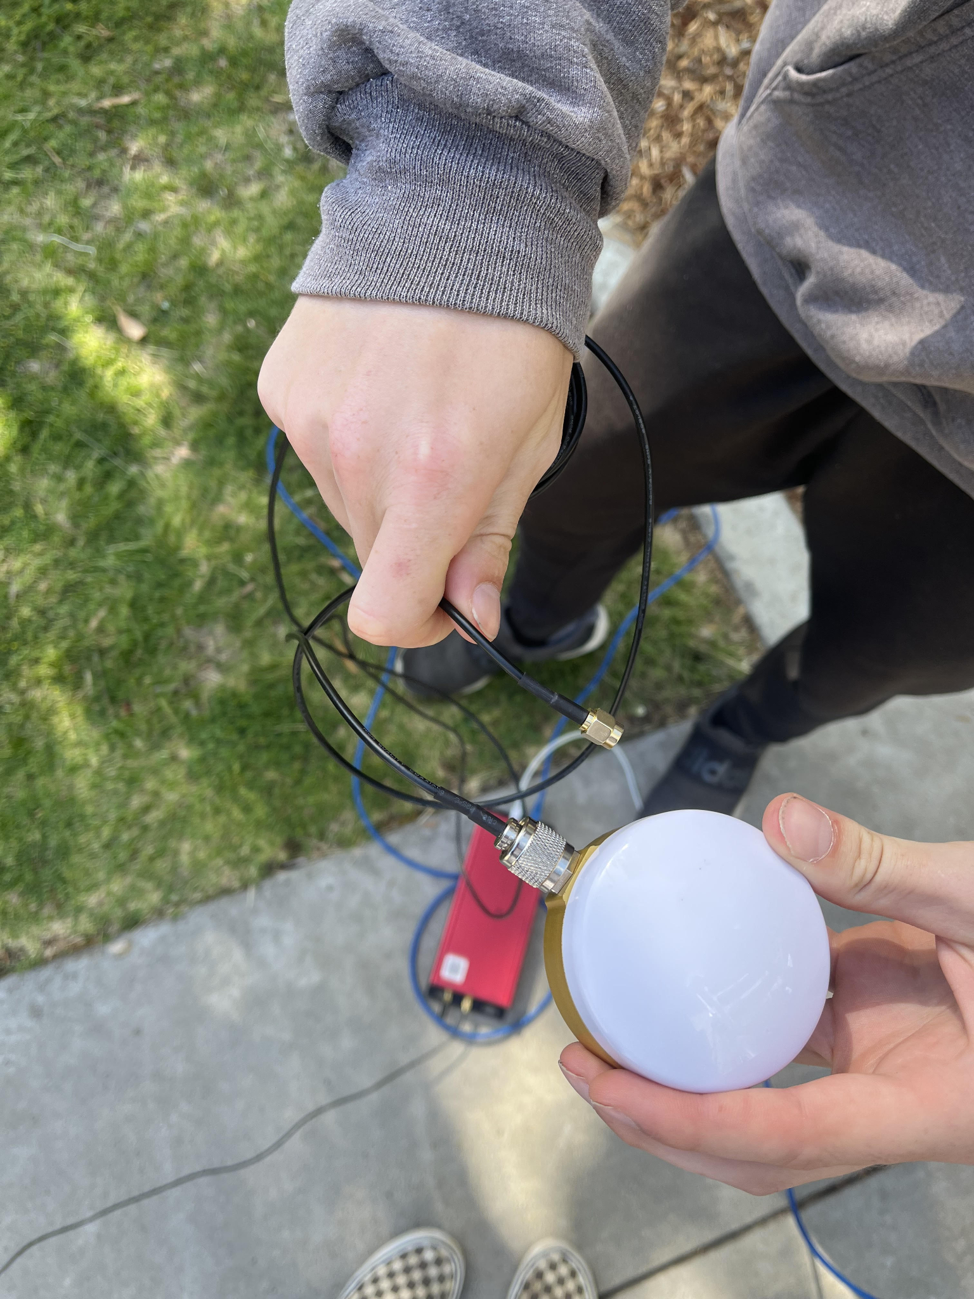

Slide 8
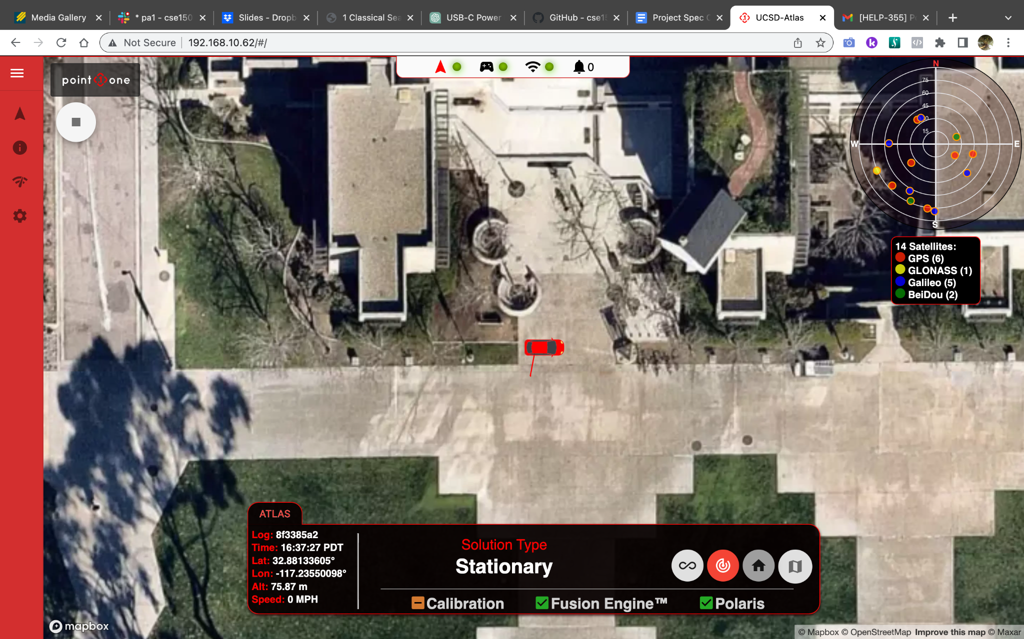
GPS/Fusion Engine Online

Slide 9
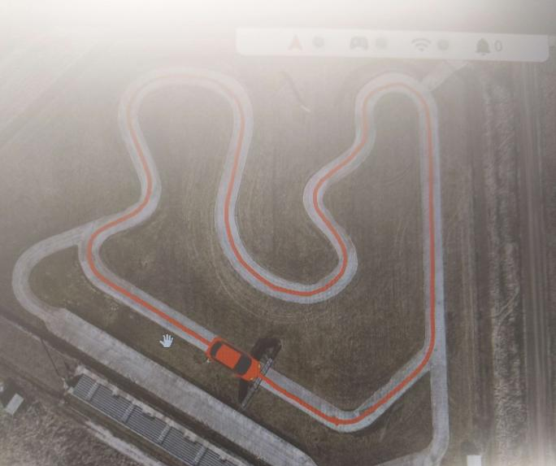
Atlas working in time For Indiana Race
“We're in Indiana and are using the ATLAS. We had no problem getting the ATLAS to power on connect and record an accurate path.”
*Write
up

Slide 10
The Second Mission
Michael,
Extract raw IMU data from the P1SDK so we can analyze its quality and determine if we should use this IMU instead of the current Artemis unit.
Thank you,
Jack
(paraphrased)

Slide 11
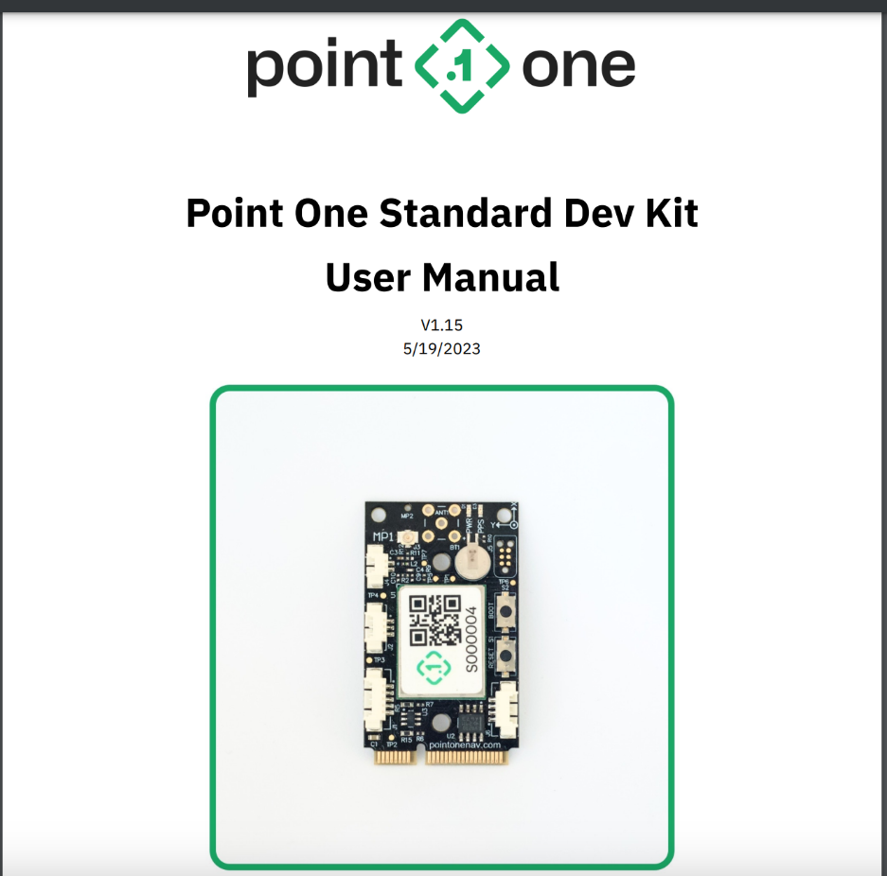
Ground Work

Slide 12
Accessing the Device - P1 runner
[ 1997.574436] usb 1-6: ch341-uart converter now attached to ttyUSB0
[ 3296.401359] ch341-uart ttyUSB0: ch341-uart converter now disconnected from ttyUSB0
[ 3311.773393] usb 1-12.1: ch341-uart converter now attached to ttyUSB0
[434024.592225] usb 1-3: ch341-uart converter now attached to ttyUSB0
[1205863.198019] usb 1-12.2: cp210x converter now attached to ttyUSB1
[1205863.200938] usb 1-12.2: cp210x converter now attached to ttyUSB2
[1206169.467171] cp210x ttyUSB1: cp210x converter now disconnected from ttyUSB1
[1206169.467788] cp210x ttyUSB2: cp210x converter now disconnected from ttyUSB2

Slide 13
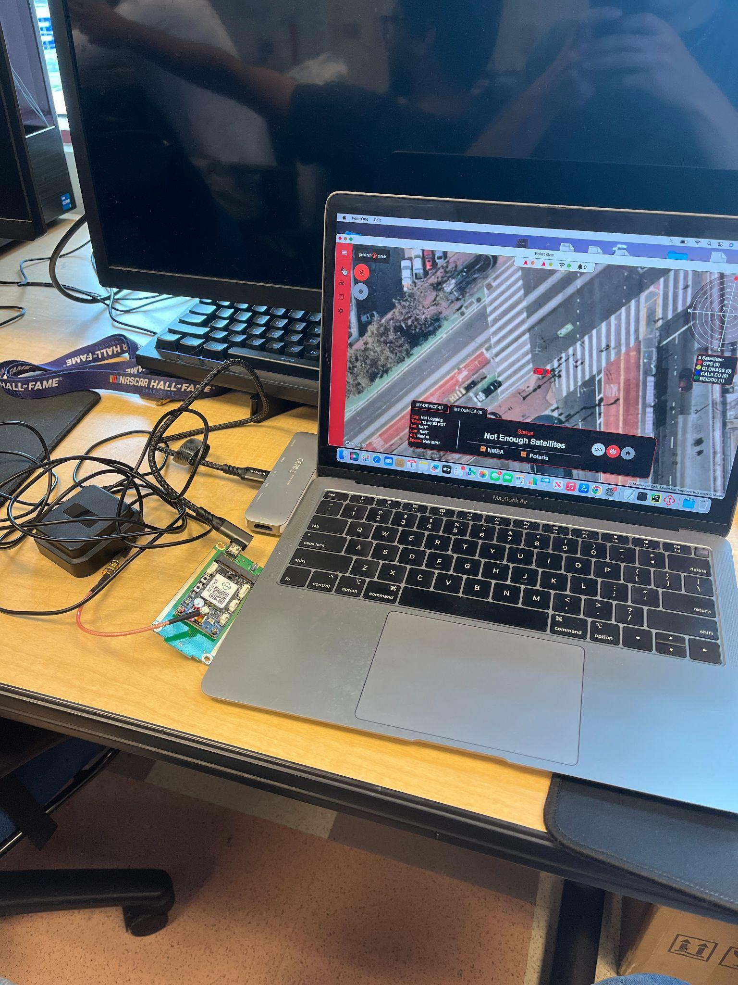
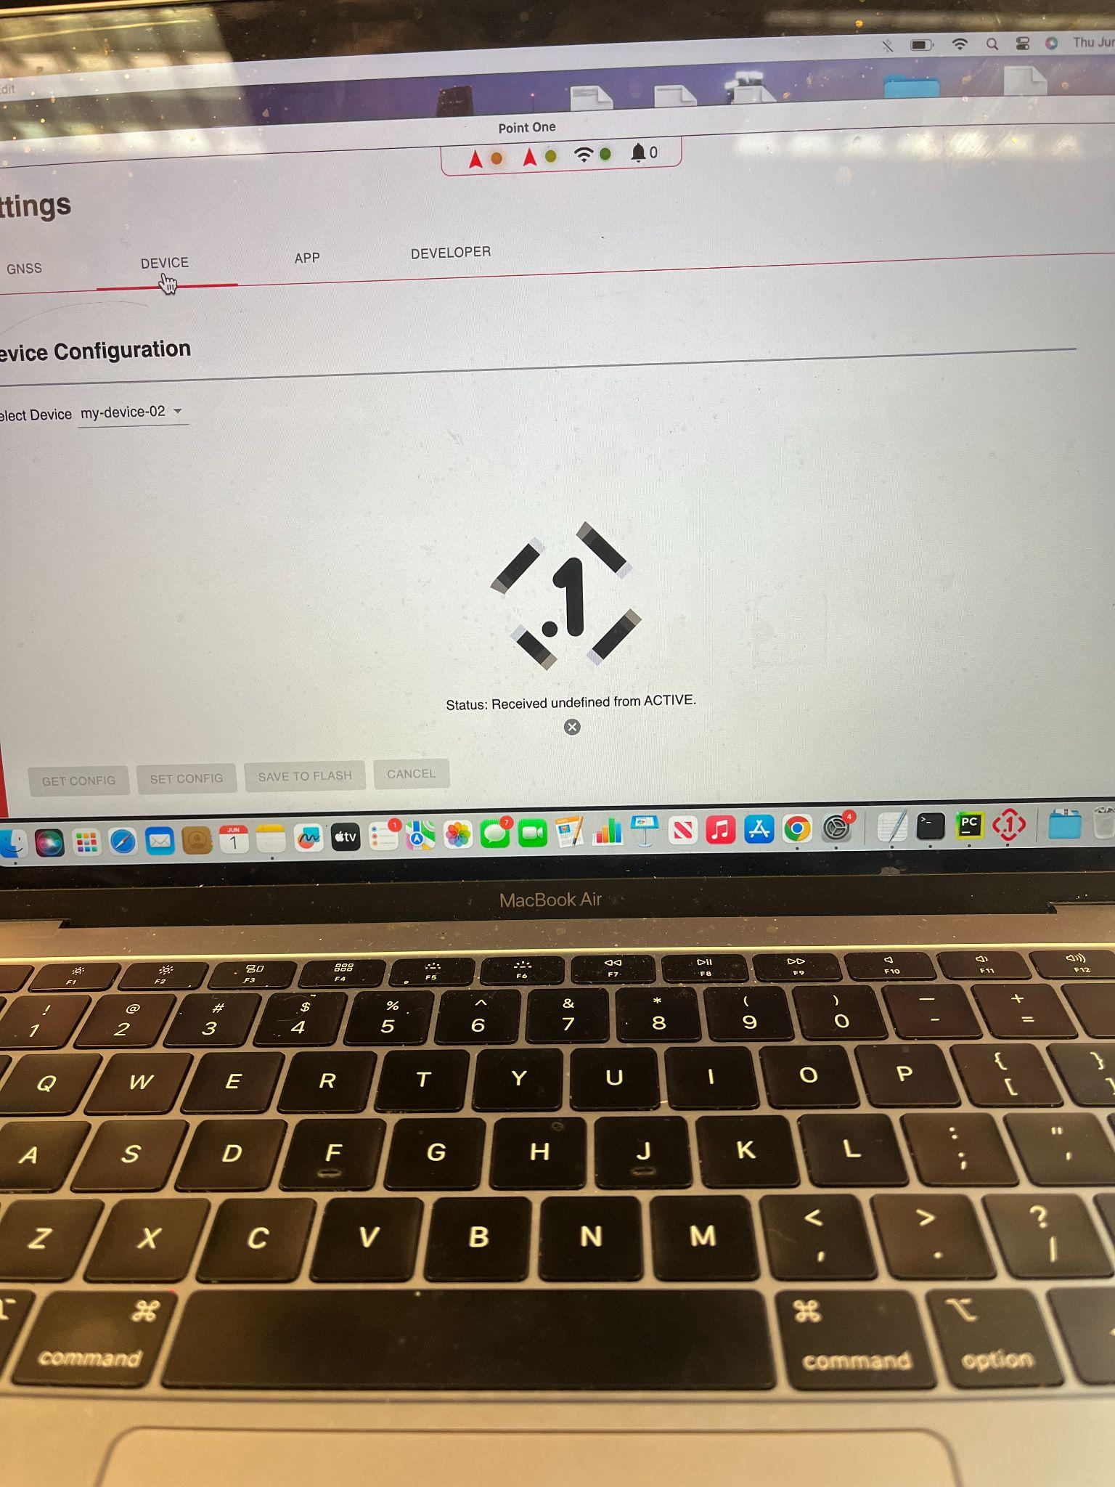
Accessing the Device - Desktop Client

Slide 14

Rebooting the Device / Installing New Firmware
Michael you need updates which require a command line tool, identifying the serial port the device is using, and a new bootloader file.

Slide 15
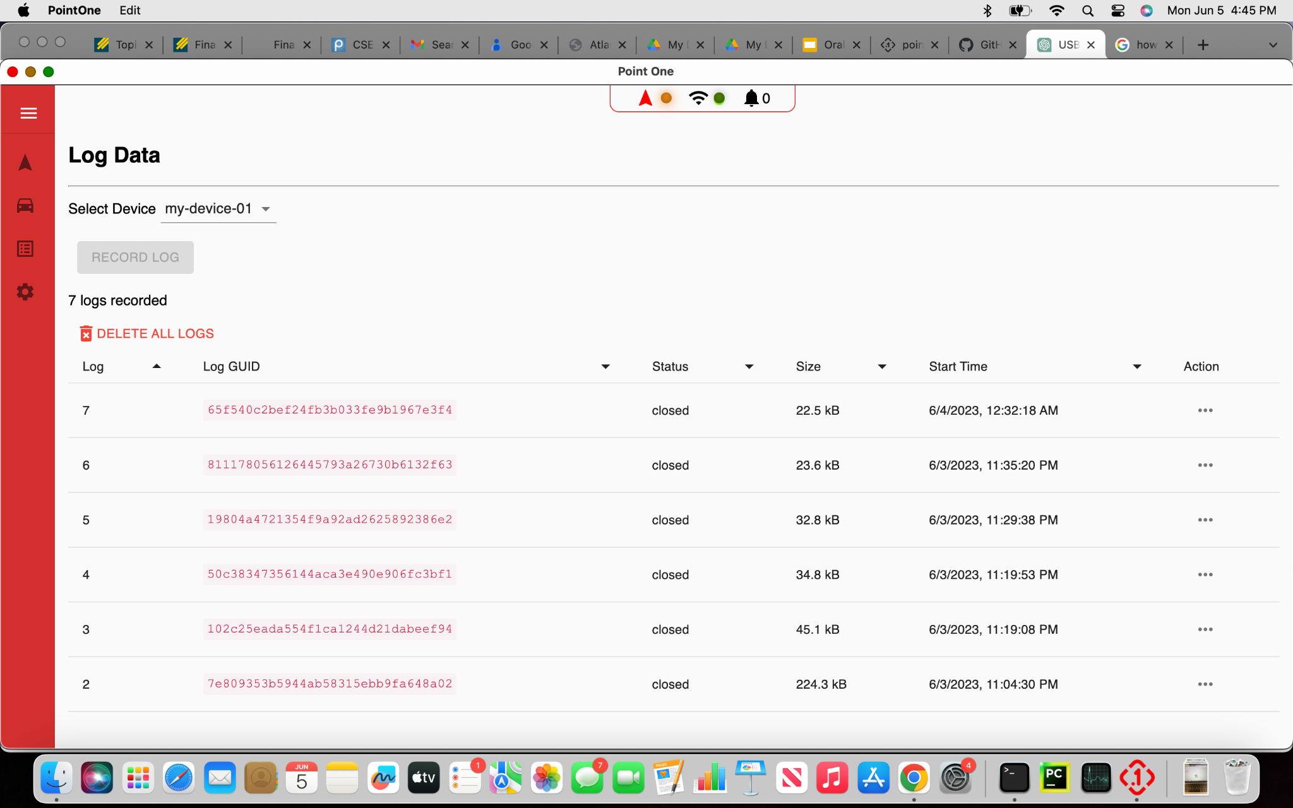
Reboot and Download Firmware
After procedure I was able to request IMU data and log the information to be opened in rosviz.
*Write Up
*Lidar

Slide 16
Conclusion
Getting devices to talk to each other is difficult
Struggles of niche items
Struggles of knowledge transfer
Thanks Triton AI

